Slide 1

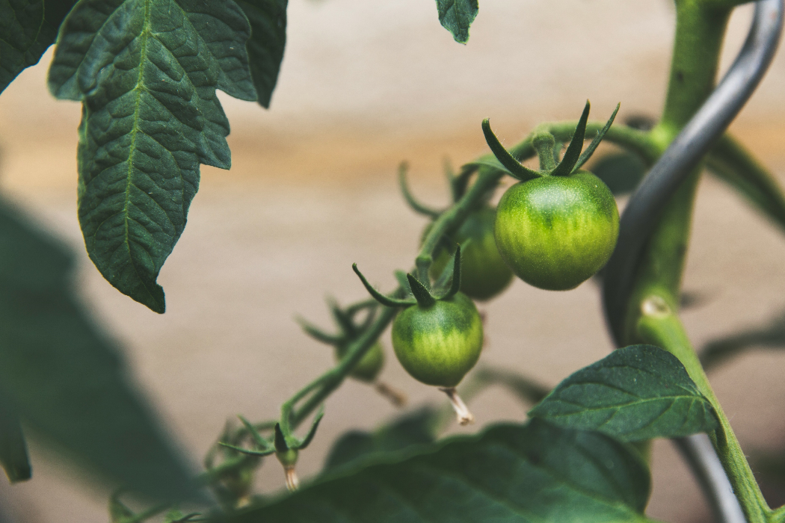
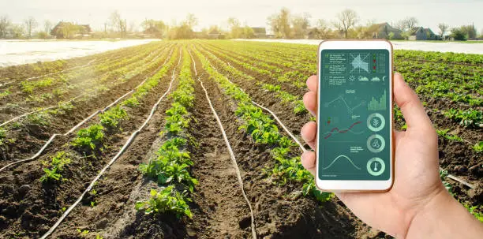

Sustainable Greenhouse Management through Smart Technology Integration
Project ID:24-25j-250

Slide 2
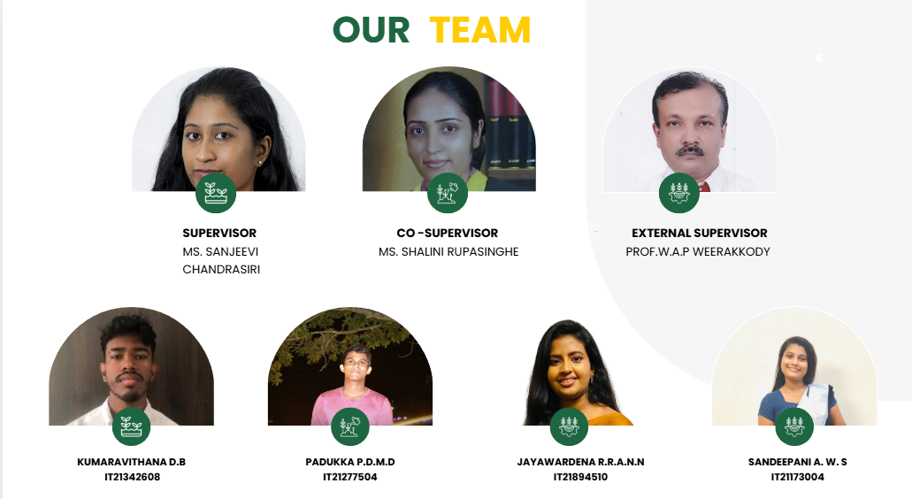
24-25J-250
Page 2

Slide 3
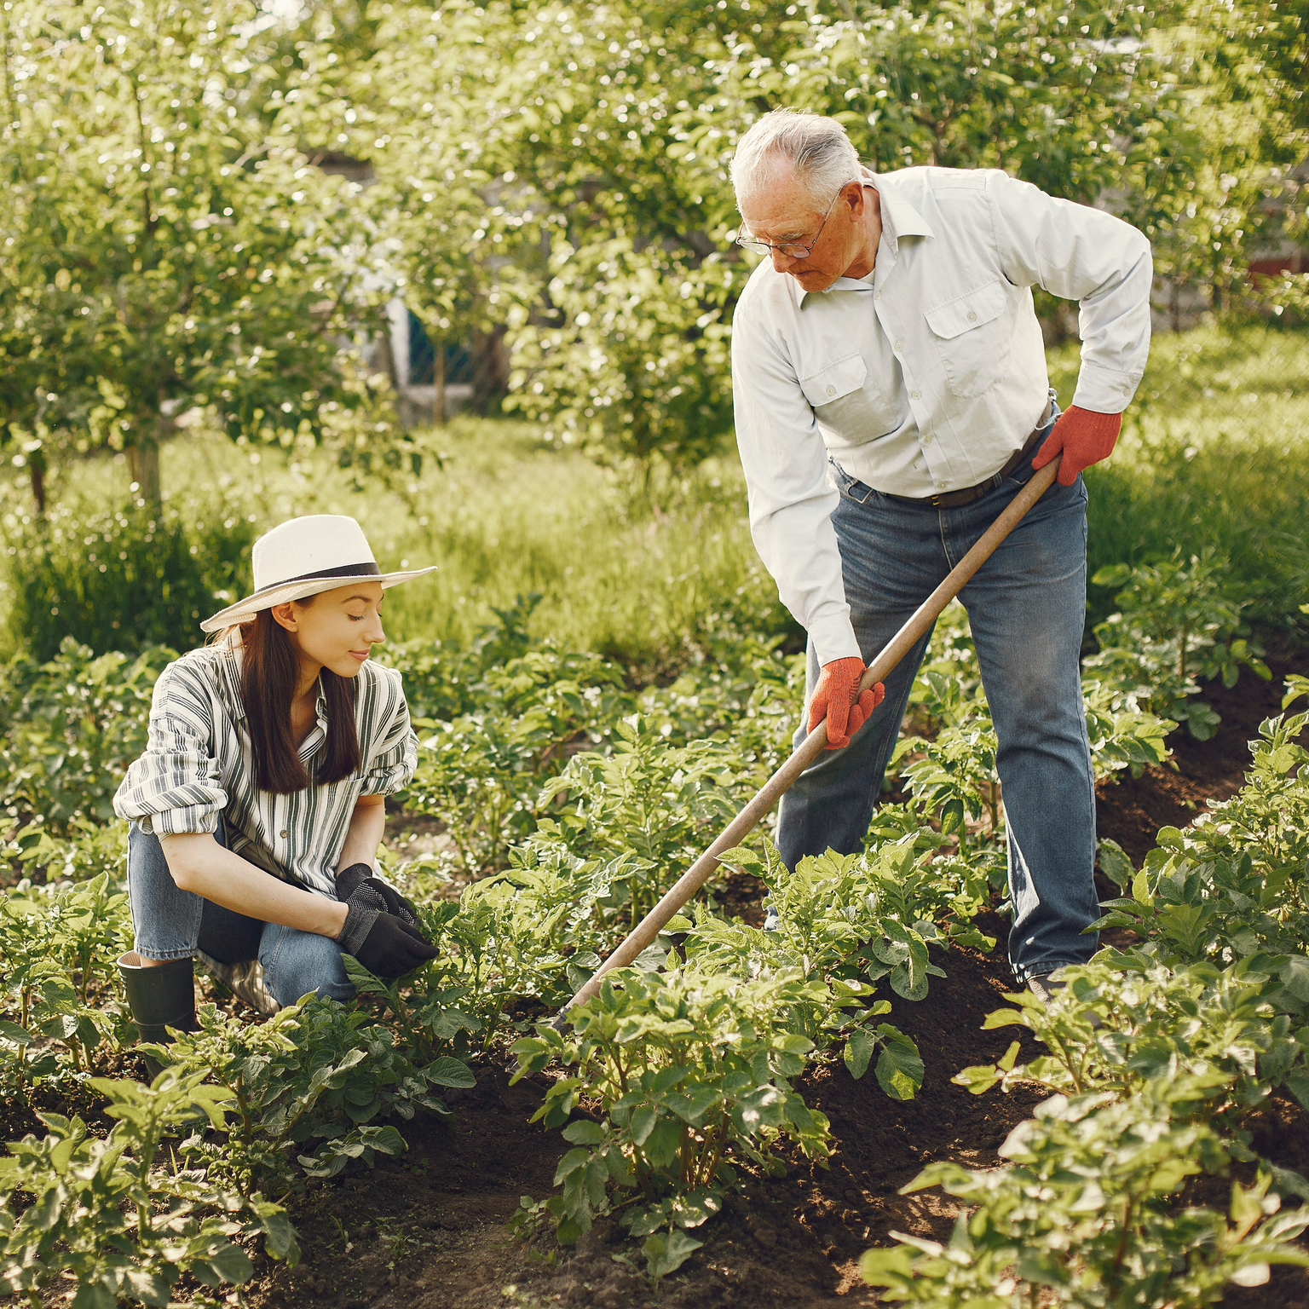
Background
Agriculture faces challenges in disease detection, disease management, pest management, and resource optimization. Traditional methods are slow and error-prone, while machine learning, particularly deep learning models like CNNs and YOLOv8, automate disease identification and severity classification, pest monitoring, and fruit ripeness prediction. These systems classify disease severity, assess pest infestations, and optimize fertilizer and irrigation use based on factors like soil nutrient levels. Machine learning models such as CatBoost and Random Forest enable data-driven decisions, improving crop yield and sustainability. These technologies enhance efficiency, reduce waste, and promote sustainable farming practices, empowering farmers with actionable insights for better resource management and productivity.
24-25J-250
Page 3

Slide 4
Research Problem
01
How can deep learning improve disease detection and severity classification in tomato crops for faster and more cost-effective interventions?
How does real-time pest monitoring using machine learning reduce pesticide use and improve pest control in greenhouses?
02
How do environmental factors and plant age affect fertilizer and water needs, and can ensemble models improve prediction accuracy?
03
How can deep learning models for fruit ripeness detection help optimize harvest timing, reduce waste, and improve crop yield?
04
24-25J-250
Page 3
Page 4

Slide 5
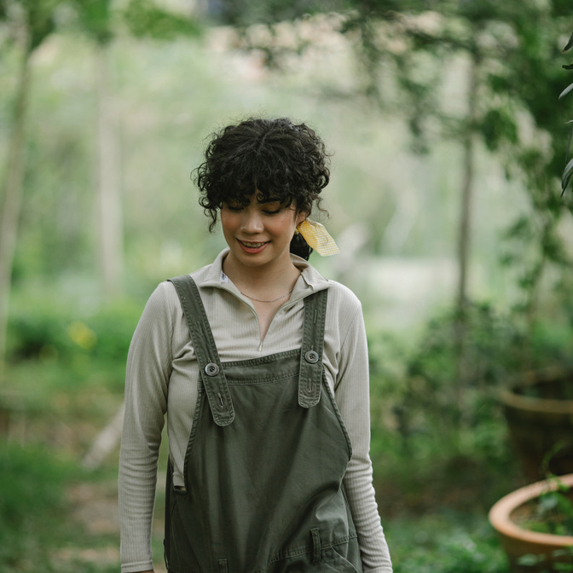
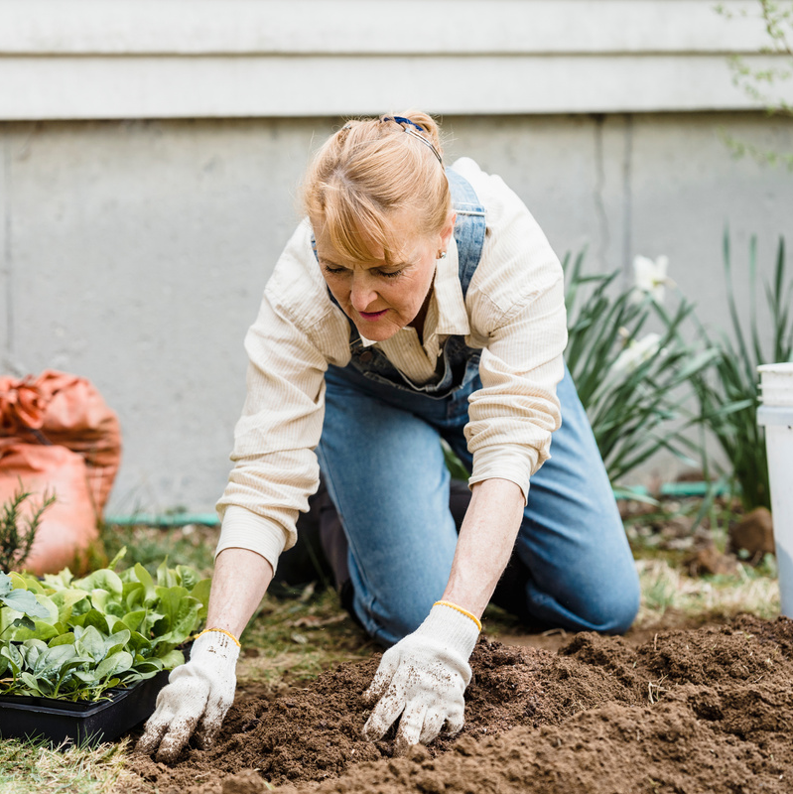
Main Objective
Achieve sustainable greenhouse management through smart technology integration, using IoT sensors, image processing for predictive adjustments, and user-friendly interfaces to enhance agricultural efficiency and sustainability.
24-25J-250
Page 5

Slide 6
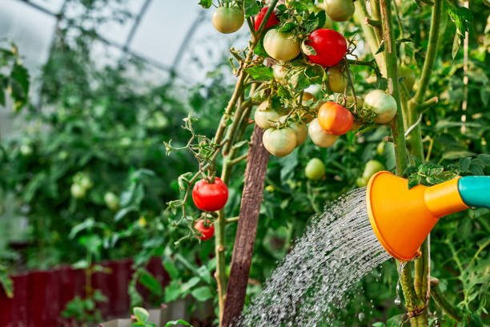
Sub Objectives
Evaluate deep learning models' effectiveness in detecting and classifying tomato disease and disease severity compared to traditional methods.
01
02
Assess real-time pest detection with machine learning's impact on reducing pesticide use in greenhouses.
03
Analyze how environmental variables and plant age affect fertilizer and water predictions using ensemble models.
Investigate deep learning models like YOLOv8 in automating fruit ripeness detection and optimizing harvest timing.
04
04
24-25J-250
Page 6

Slide 7
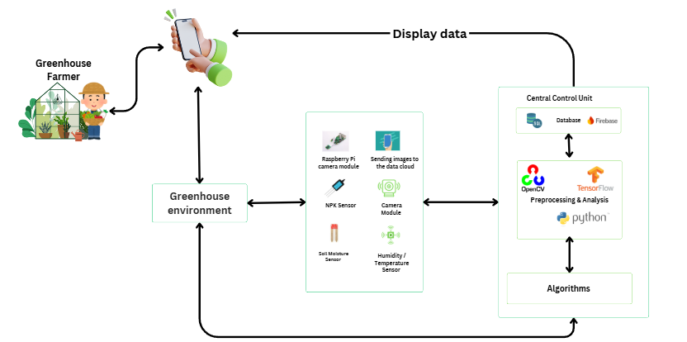
System Diagram
24-25J-250
Page 7

Slide 8
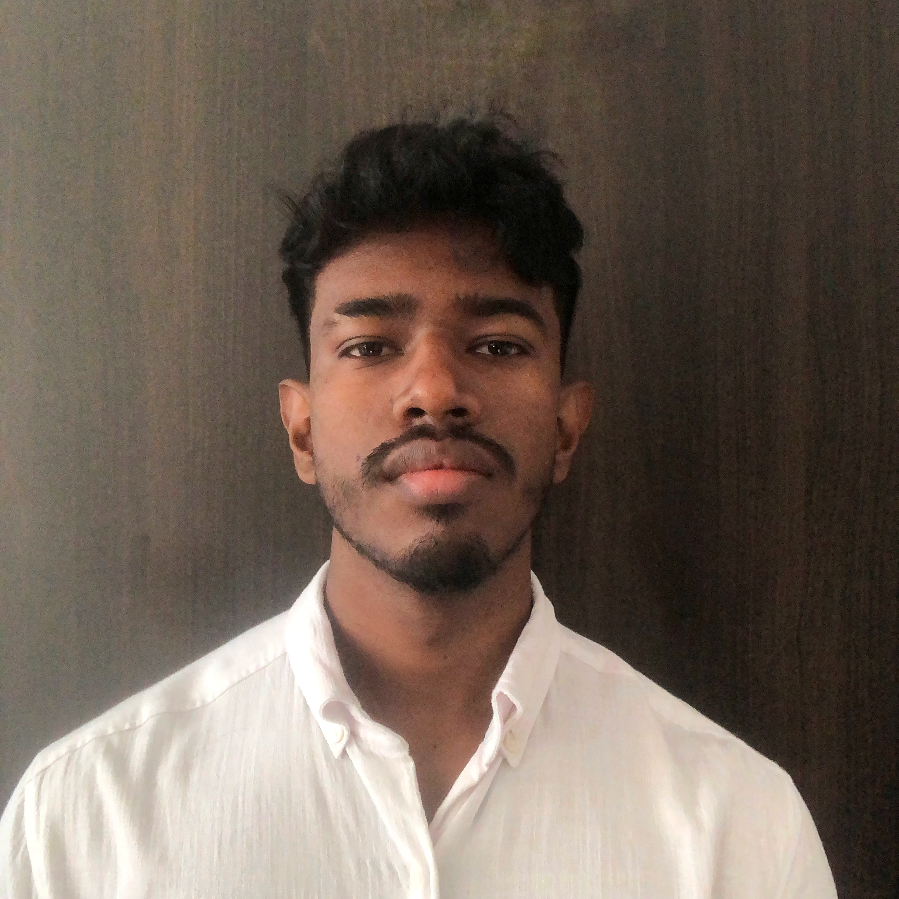
Automated Ripeness Sensing with Environmental and Harvest Prediction System
IT21342608 | Kumaravithana D.B
Software Engineering
IT21342608 | Kumaravithana D.B | 24-25J-250
Page 45

Slide 9
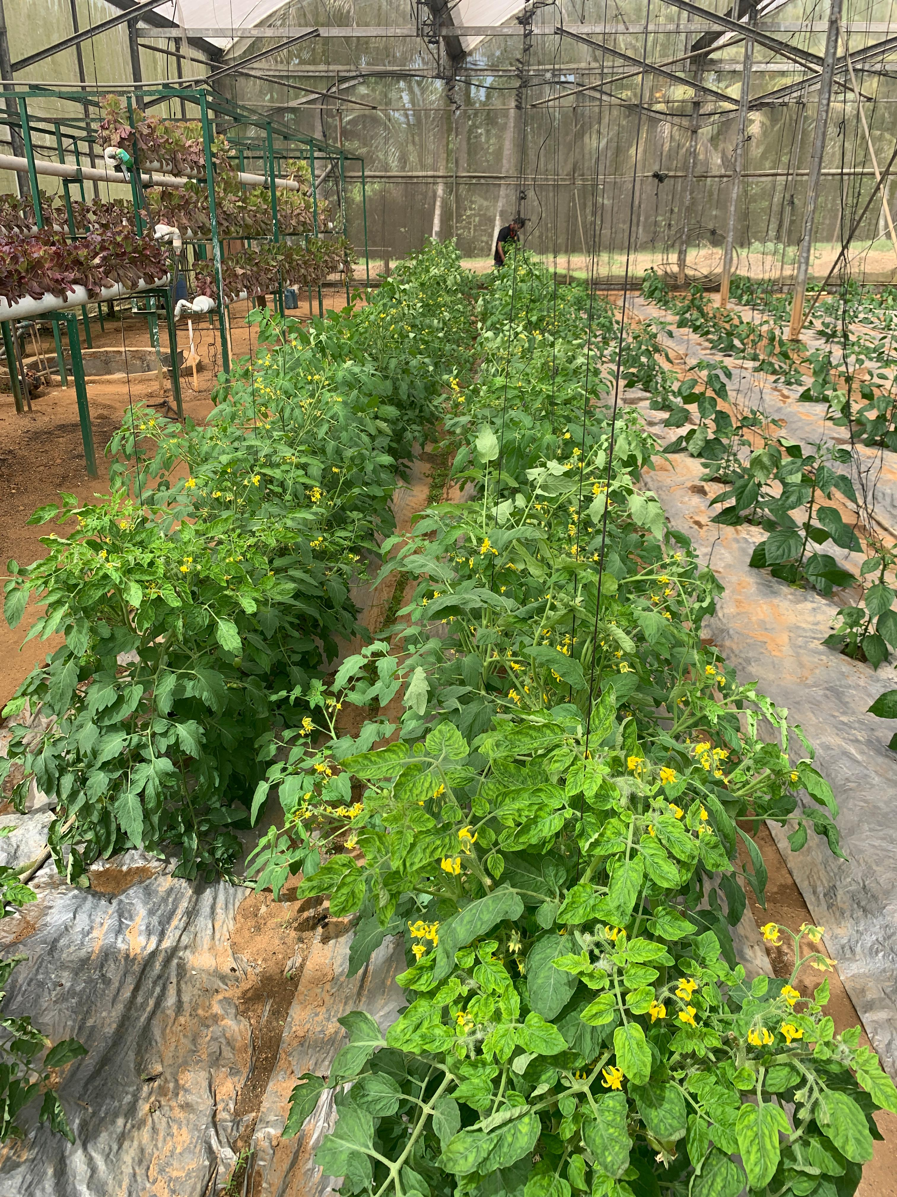
Background
This system allows users to capture photos using their mobile devices for periodic fruit monitoring, analyzing ripeness indicators to estimate the percentage of fruit maturity. A key feature is its ability to predict the best harvest time with high accuracy, ensuring fruits are picked at peak ripeness. Additionally, the system suggests optimal environmental conditions that can be adjusted to enhance the ripening process. These novel capabilities—accurate harvest prediction and tailored environmental recommendations—enable farmers to improve ripeness detection, reduce waste, and maximize agricultural efficiency.
IT21342608 | Kumaravithana D.B | 24-25J-250
Page 46

Slide 10
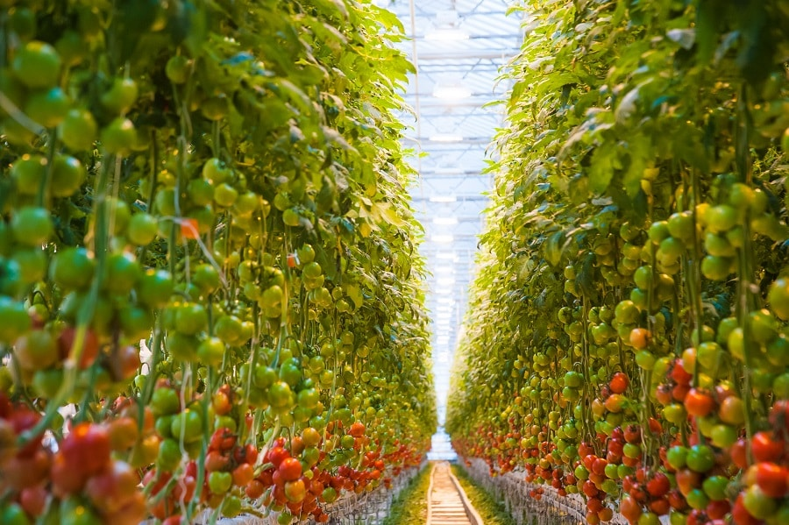
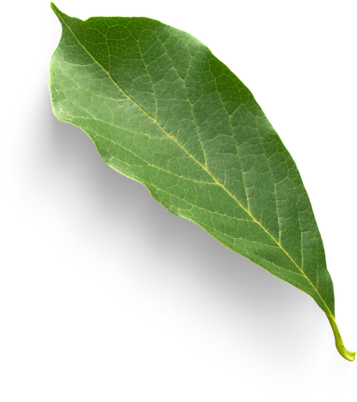
Research Question?
How can automated fruit ripeness detection improve the accuracy of predicting the optimal harvest time?
01
What impact does machine learning-based ripeness assessment have on reducing waste and increasing farming efficiency?
02
How can suggesting optimal environmental conditions based on ripeness data improve the ripening process and crop yield?
03
IT21342608 | Kumaravithana D.B | 24-25J-250
Page 47

Slide 11
Objectives
To develop and implement a deep learning-based system for the automated detection of fruit ripeness, predict the optimal harvest time, and provide actionable recommendations for adjusting environmental conditions to maximize crop quality and reduce waste.
IT21342608 | Kumaravithana D.B | 24-25J-250
Page 48

Slide 12
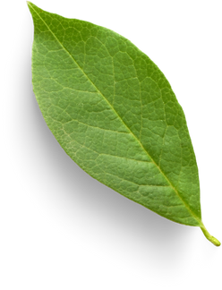
Sub Objectives
01
Develop a system that allows users to capture images using their mobile devices to detect and classify ripeness indicators, enabling precise assessment of fruit maturity levels.
02
Predict the optimal harvest time based on the detected ripeness indicators, ensuring fruits are harvested at their peak quality.
03
Provide periodic recommendations for adjusting environmental conditions to optimize fruit ripening, improving crop quality and reducing waste.
04
IT21342608 | Kumaravithana D.B | 24-25J-250
Page 49

Slide 13
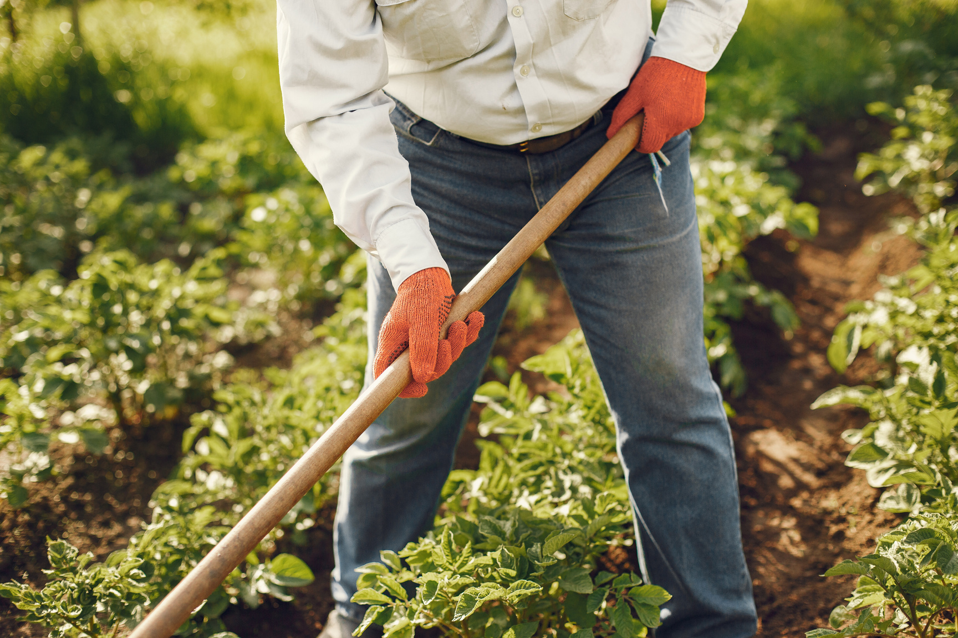
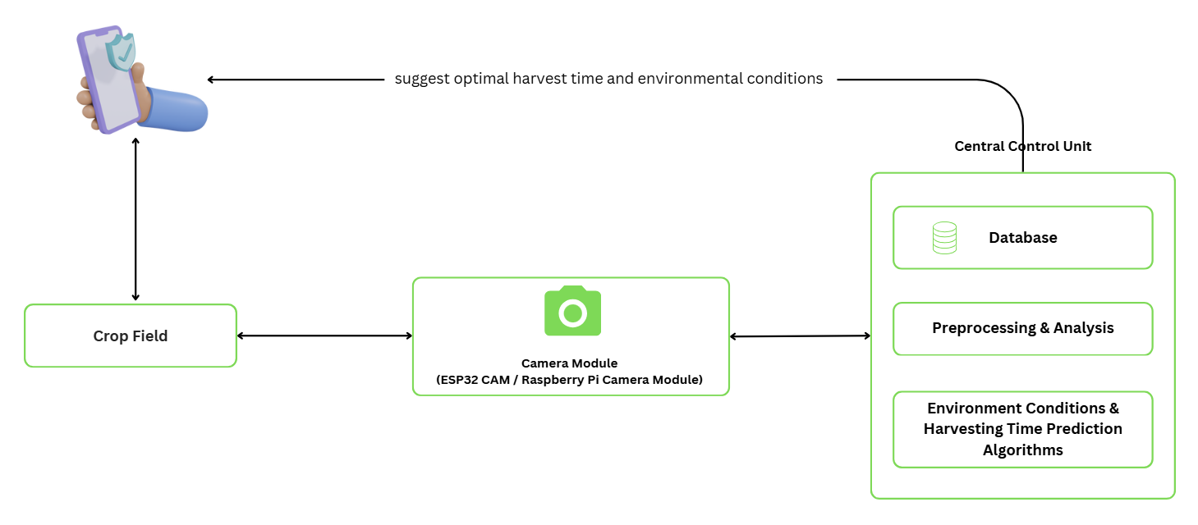
System Diagram
Integrating Trees
IT21342608 | Kumaravithana D.B | 24-25J-250
Page 50

Slide 14

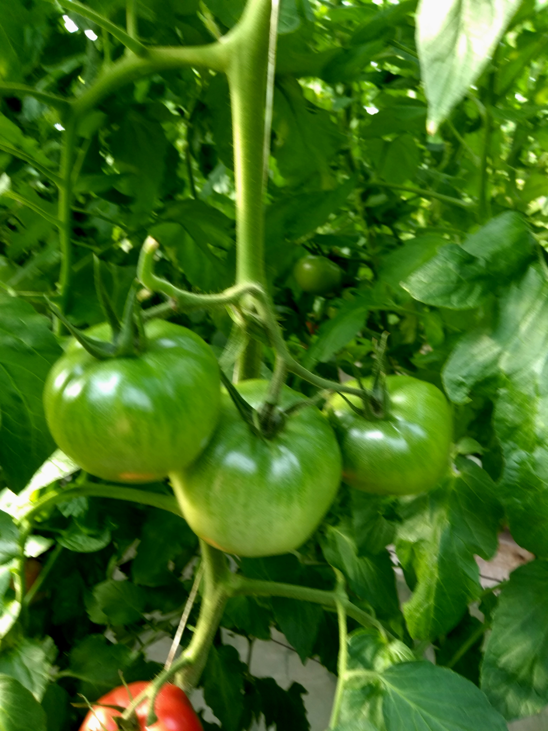
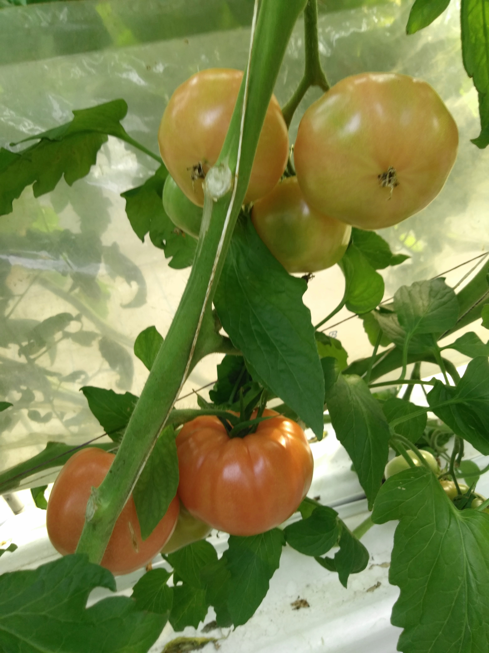
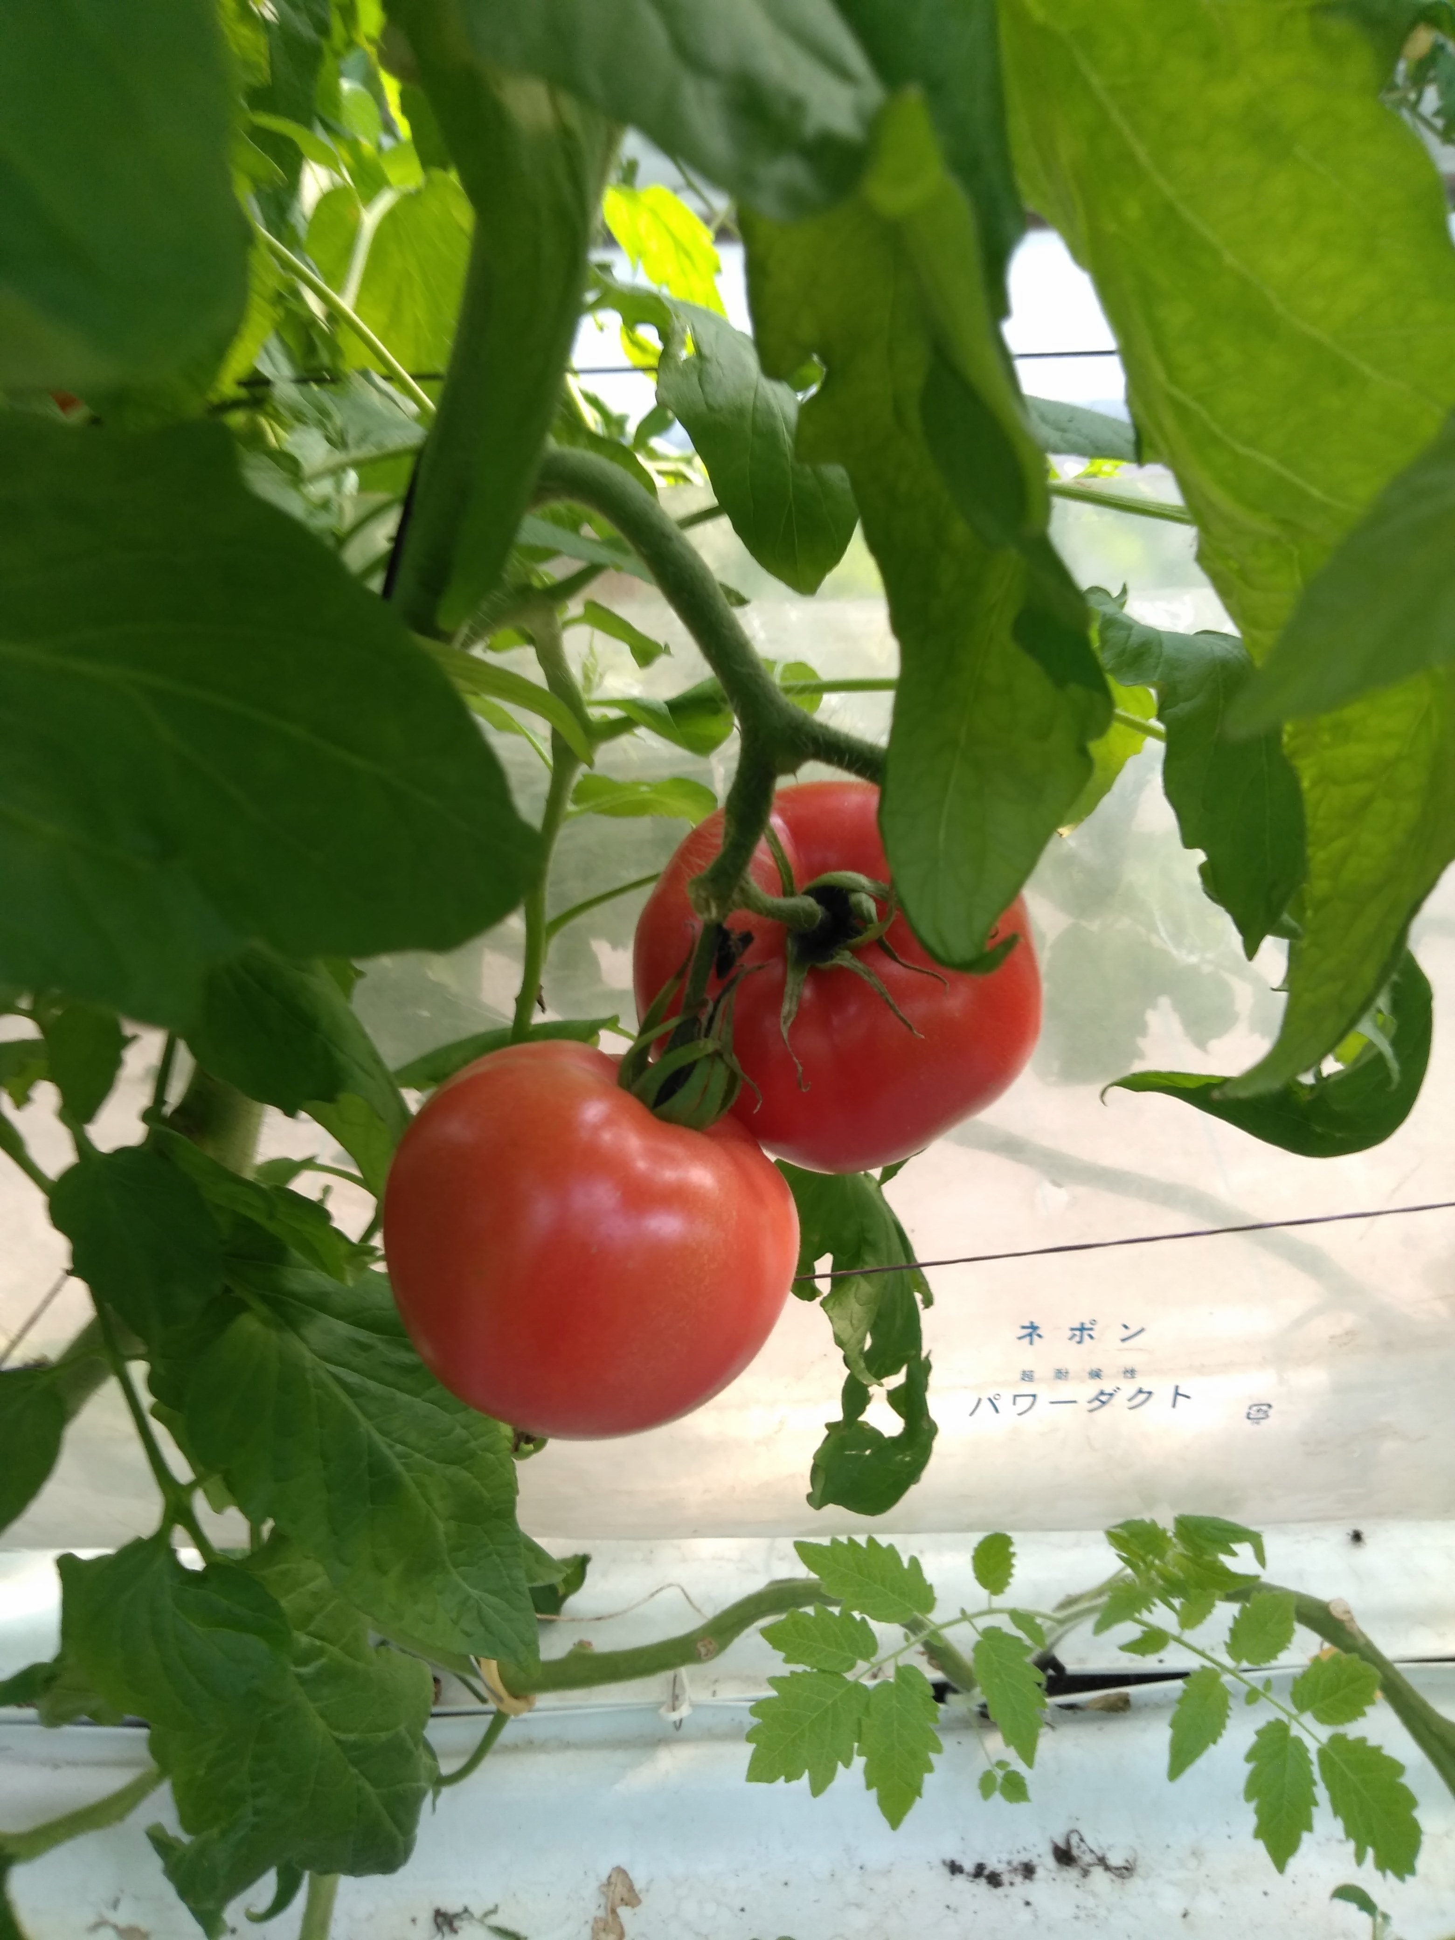
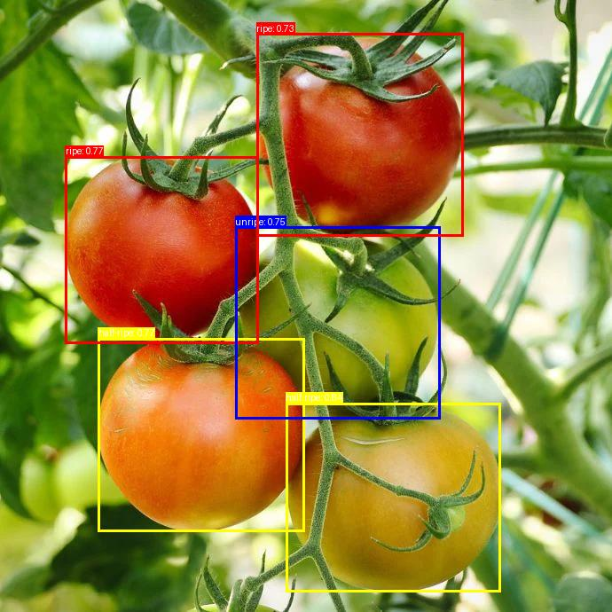
Methodology – Evidence of Completion
Data Collection
1.Images of different ripenesee stages collected on-site from greenhouse and Labeling them manually
IT21173004| Sandeepani A.W.S | 24-25J-250
Page 21

Slide 15

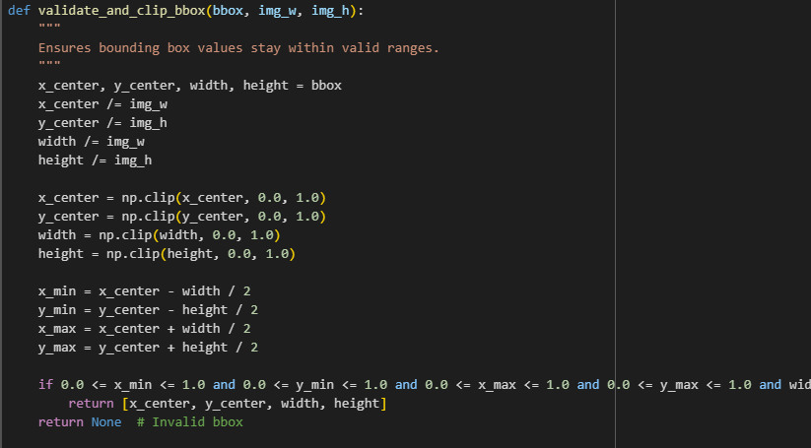
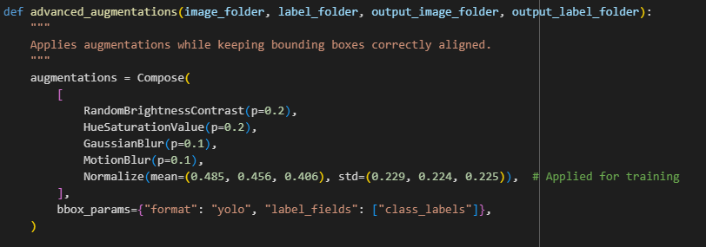
Methodology – Evidence of Completion
Data Preprocessing
Data preprocessing includes annotation, augmentation, resizing, and dataset splitting to enhance model accuracy.
IT21173004| Sandeepani A.W.S | 24-25J-250
Page 21

Slide 16

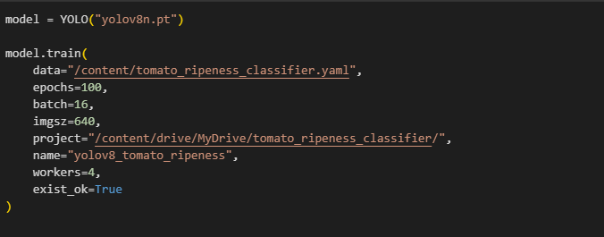
Methodology – Evidence of Completion
Training
IT21173004| Sandeepani A.W.S | 24-25J-250
Page 21

Slide 17

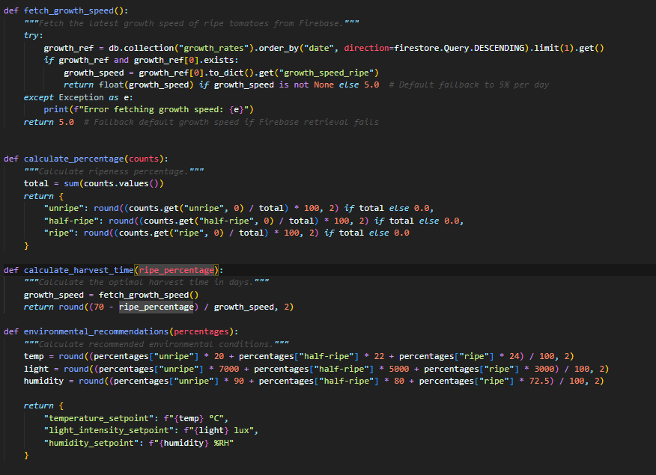
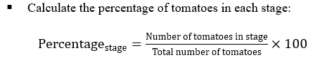
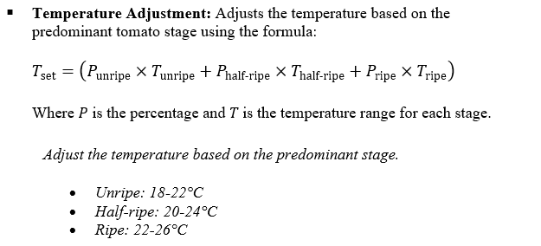
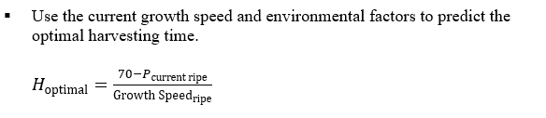
Methodology – Evidence of Completion
Set Thresholders
IT21173004| Sandeepani A.W.S | 24-25J-250
Page 21

Slide 18


Functional Requirements
Image Input Processing
Ripeness Detection
Harvest Time Prediction
Environmental Condition Recommendations
IT21342608 | Kumaravithana D.B | 24-25J-250
Page 51

Slide 19
Non Functional Requirements
Performance
Reliability & Availability
Usability
IT21342608 | Kumaravithana D.B | 24-25J-250
Page 52

Slide 20
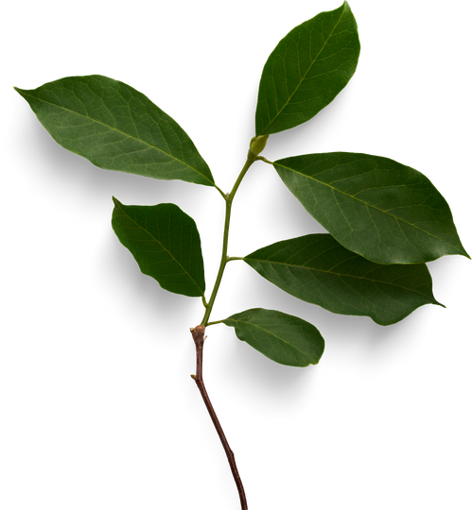
Completion and Future Works
Completed Components(PP1)
Completed Components(PP2)
01
Model has successfully trained to identified the ripeness stage of each fruit from an image
Enviornmental condition recommendation system
Harvesting time calculation
After Identifying the ripeness stage and It suggest the percentage of each stages
Mobile Application Implementation
02
Backend implementation for firebase
Integrate backend with mobile application
IT21173004| Sandeepani A.W.S | 24-25J-250
Page 21

Slide 21

Tools and Technologies
Technologies
Programming Language
Python
Flutter
Libraries & Frameworks
Ultralytics
Albumentations
OpenCV
IT21173004| Sandeepani A.W.S | 24-25J-250
Page 21

Slide 22
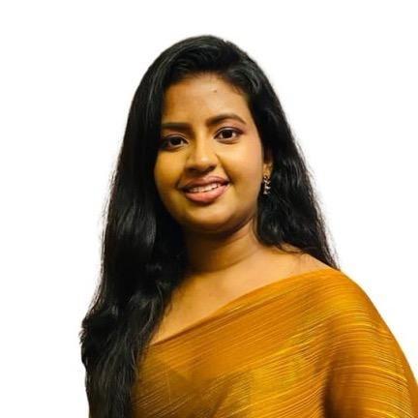
Tomato Disease Detection and Severity Prediction with Management Suggestions
IT21894510 | Jayawardena R.R.A.N.N
Software Engineering
IT21894510 | Jayawardena R.R.A.N.N| 24-25J-250
Page 8
IT21894510 | Jayawardena R.R.A.N.N| 24-25J-250

Slide 23
Background
Tomato crops are vital for agriculture worldwide, and diseases significantly affect their yield and quality. Early detection and accurate diagnosis of tomato diseases, especially in their different severity stages, are essential for effective management. This project aims to provide an automated system using machine learning to identify diseases in tomato plants and classify the severity of these diseases. By leveraging disease severity levels (mild, moderate, severe), farmers can receive tailored recommendations to manage the disease and protect their crops.
IT21894510 | Jayawardena R.R.A.N.N| 24-25J-250
Page 9

Slide 24
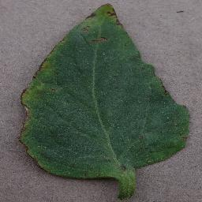
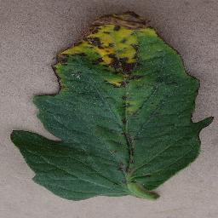
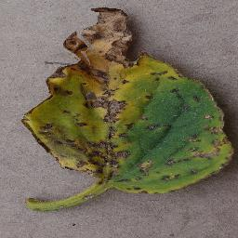
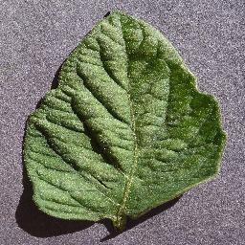
Research Question?
01
How can machine learning models be used to accurately detect tomato diseases from images?
How can we classify the severity of tomato diseases (mild, moderate, severe) using a machine learning approach?
02
How can an automated system provide real-time, actionable recommendations based on disease severity to farmers?
03
IT21894510 | Jayawardena R.R.A.N.N| 24-25J-250
Page 10

Slide 25
Objectives
This project aims to develop a deep learning model for detecting tomato diseases from images and classifying their severity into mild, moderate, and severe categories. Based on the severity, the system provides tailored recommendations for disease management. A user-friendly frontend enables farmers to upload images, view disease diagnoses, and receive personalized recommendations, enhancing crop health and productivity.
IT21894510 | Jayawardena R.R.A.N.N| 24-25J-250
Page 11

Slide 26
Sub Objectives
Preprocess and organize tomato disease image data for model training.
01
Train and integrate a severity classification model for real-time disease analysis.
02
Develop and implement a recommendation system based on disease severity, with a mobile application for easy interaction by farmers.
03
04
IT21894510 | Jayawardena R.R.A.N.N| 24-25J-250
Page 12

Slide 27
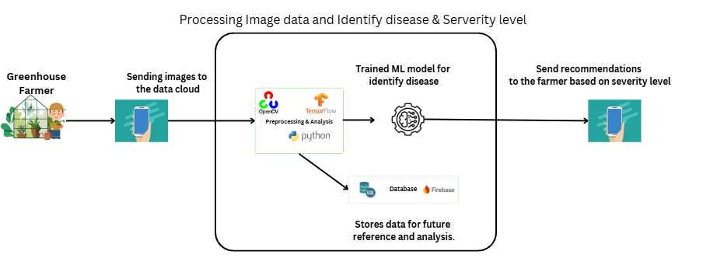
System Diagram
Integrating Trees
IT21894510 | Jayawardena R.R.A.N.N| 24-25J-250
Page 13

Slide 28
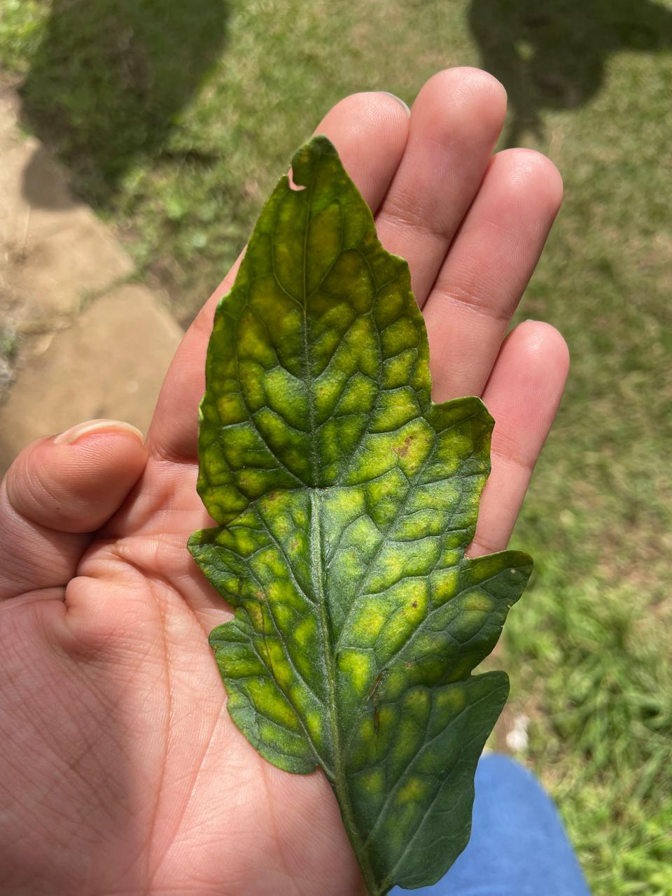
Algorithms & Architectures
Technologies
Convolutional Neural Network
EfficientNet Model
Programming Language
Python
Flutter
Libraries & Frameworks
Pandas
OpenCV
NumPy
Scikit-Learn
TensorFlow/Keras
Matplotlib
Techniques
Data Collection & Preprocessing
Data Splitting
Model Building & Training
Evaluation
Loss Function & Optimizer
IT21894510 | Jayawardena R.R.A.N.N| 24-25J-250
Page 14

Slide 29
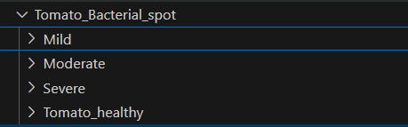
Methodology
01
Data Collection
The dataset was created using online resources and publicly available datasets.
Images were categorized into three severity levels of tomato bacterial spots:
Mild
Moderate
Severe
The classification of severity levels was based on pathology expertise and a detailed understanding of tomato disease progression.
This process ensured accurate and reliable labeling for training the model.
02
Preprocessing
Data Augmentation
Image Preprocessing

Slide 30
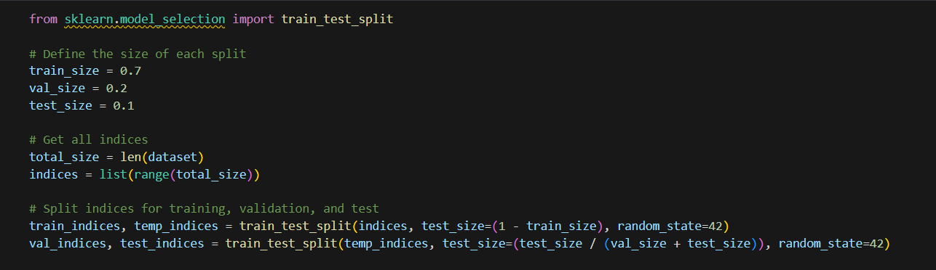
03
Model Development
Disease Detection Model
Severity Classification
04
Model Training
The dataset is split into training, validation, and test sets to ensure effective training and accurate evaluation.
The Adam Optimizer is used for efficient training, while Cross-Entropy Loss calculates the error between predictions and actual labels.
The pre-trained EfficientNet model is fine-tuned for the tomato disease classification task

Slide 31
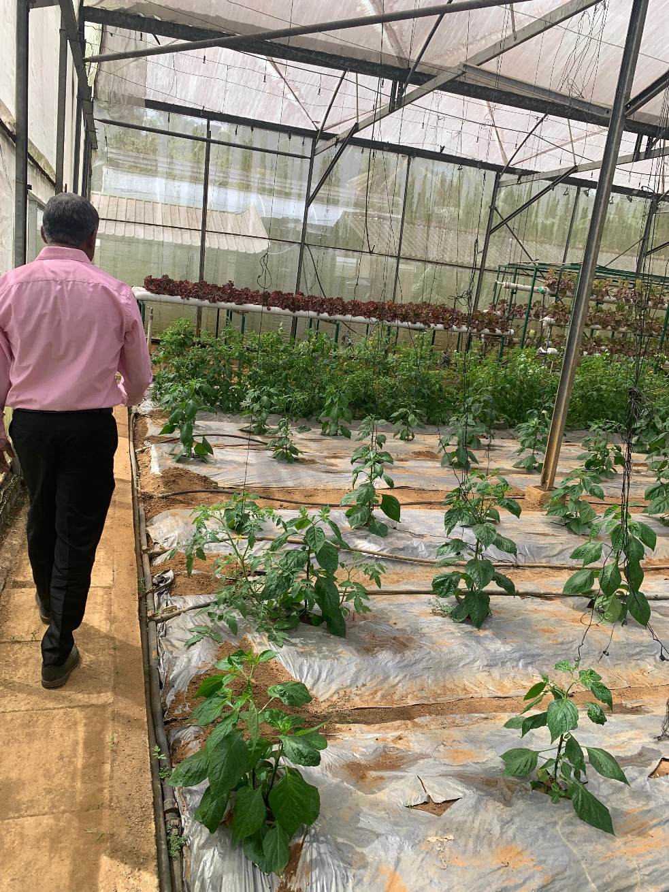
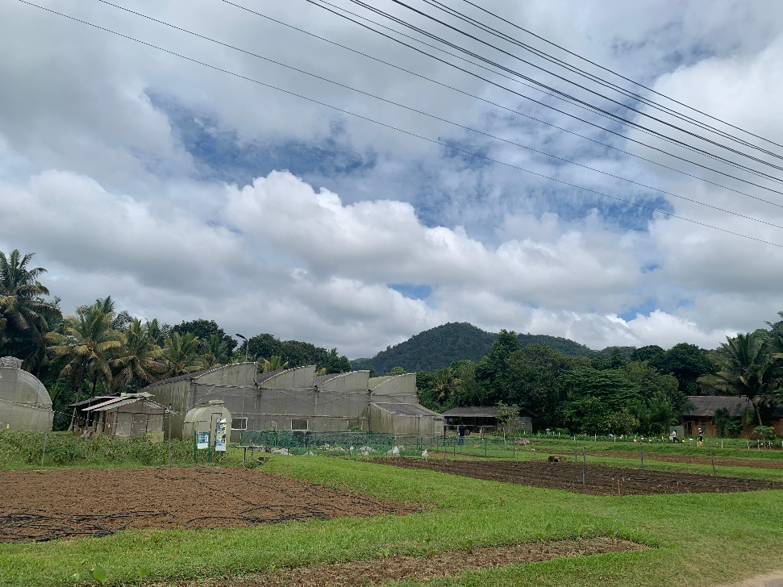
Frontend Development
05
A Flutter-based mobile app is developed to allow farmers to upload images of tomato plants. The app provides real-time diagnosis of the disease, displaying the severity level (Mild, Moderate, Severe) and offering tailored recommendations based on the severity.

Slide 32
Functional Requirements
Image Input Processing
Disease Detection
Severity Classification
Disease Management Recommendations based on severity
IT21894510 | Jayawardena R.R.A.N.N| 24-25J-250
Page 15

Slide 33
Non-Functional Requirements
Performance
Scalability
Reliability & Availability
Usability
IT21894510 | Jayawardena R.R.A.N.N| 24-25J-250
Page 16

Slide 34
Reference
[1] T. Dharmasena, R. de Silva, N. Abhayasingha, and P. Abeygunawardhana, "Autonomous cloud robotic system for smart agriculture," in *Proc. 2019 Moratuwa Engineering Research Conference (MERCon)*, Moratuwa, Sri Lanka, 2019, pp. 388-393.
[2] S. K. Kumara, R. Weerakkody, and S. Epasinghe, "Viability of Controlled Environmental Agriculture for Vegetable Farmers in Sri Lanka," Hector Kobbekaduwa Agrarian Research and Training Institute, Colombo, Sri Lanka, Tech. Rep., 2015.
[3] T.S. Fernando, R. Nethmi, A. Silva, A. Perera, R. De Silva, and P. K. W. Abeygunawardhana, “Intelligent Disease Detection System for Greenhouse with a Robotic Monitoring System,” 1 in Proc. IEEE Conf. on Advancements in Computing (ICAC), 2020, pp. 1-7.
[4] Zhang, M., et al. (2020). "A deep learning model for predicting risks of crop pests and diseases from sequential environmental data." Journal of Plant Pathology.
Page 19

Slide 35

Enhancing Fertilization and
Irrigation Management with Real Time Plant Absorption Data
IT21277504 | Padukka P.D.M.D
Software Engineering
IT21277504 | Padukka P.D.M.D | 24-25J-250
IT21277504 | Padukka P.D.M.D | 24-25J-250
IT21277504 | Padukka P.D.M.D | 24-25J-250
IT21277504 | Padukka P.D.M.D | 24-25J-250
Page 28

Slide 36
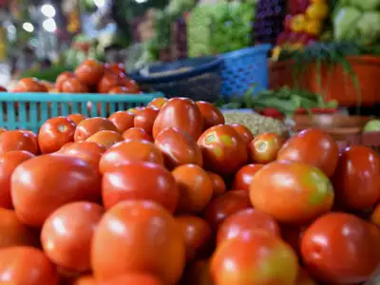
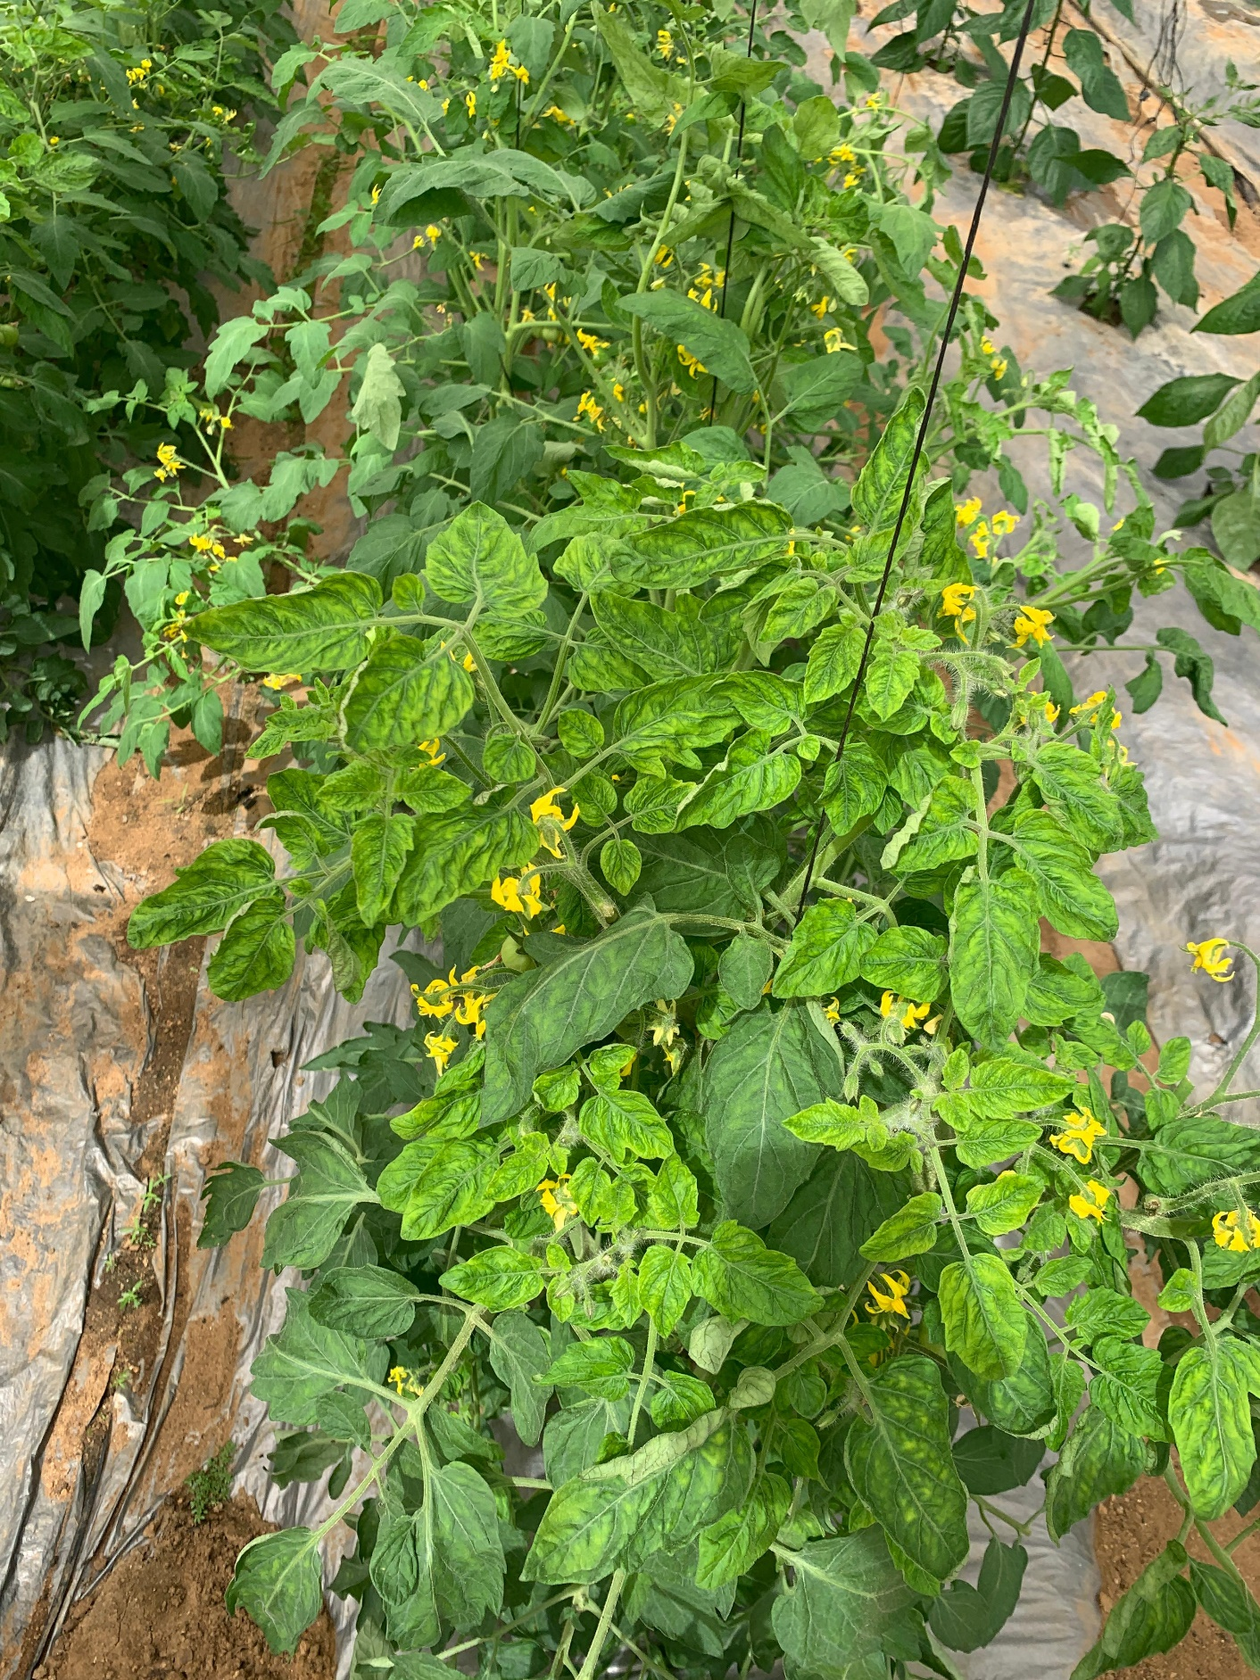
Background
Traditional greenhouse management relies on traditional methods, leading to inefficiencies. Conventional fertilization and irrigation techniques can result in over-fertilization and excessive water usage. Additionally, these methods lack the ability to measure plant nutrient absorption accurately. To address these challenges, we are implementing machine learning models that utilize real-time data, such as soil moisture, NPK levels, and plant age, to optimize irrigation and fertilization. By analyzing these factors, our ML-driven approach ensures precise resource management, minimizes waste, and enhances overall crop productivity.
2
IT21277504 | Padukka P.D.M.D | 24-25J-250
Page 29

Slide 37
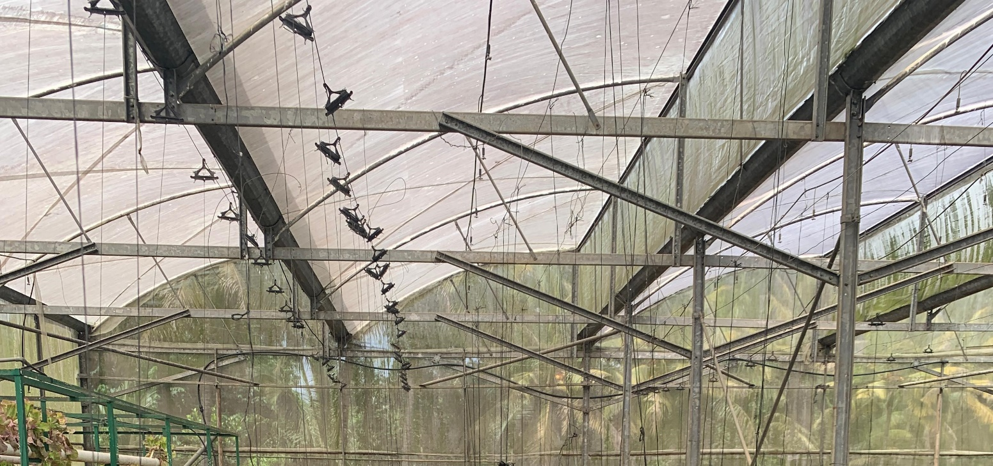
Research Question?
How do different NPK values, plant age, and fertilizer types influence the optimal amount of fertilizer needed for plant growth?
01
How do soil moisture levels and plant age affect the amount of water needed for plant growth?
02
Can using a Voting Regressor improve the accuracy of predicting fertilizer and water amounts compared to individual models like CatBoost and LGM?
03
IT21277504 | Padukka P.D.M.D | 24-25J-250
Page 30

Slide 38
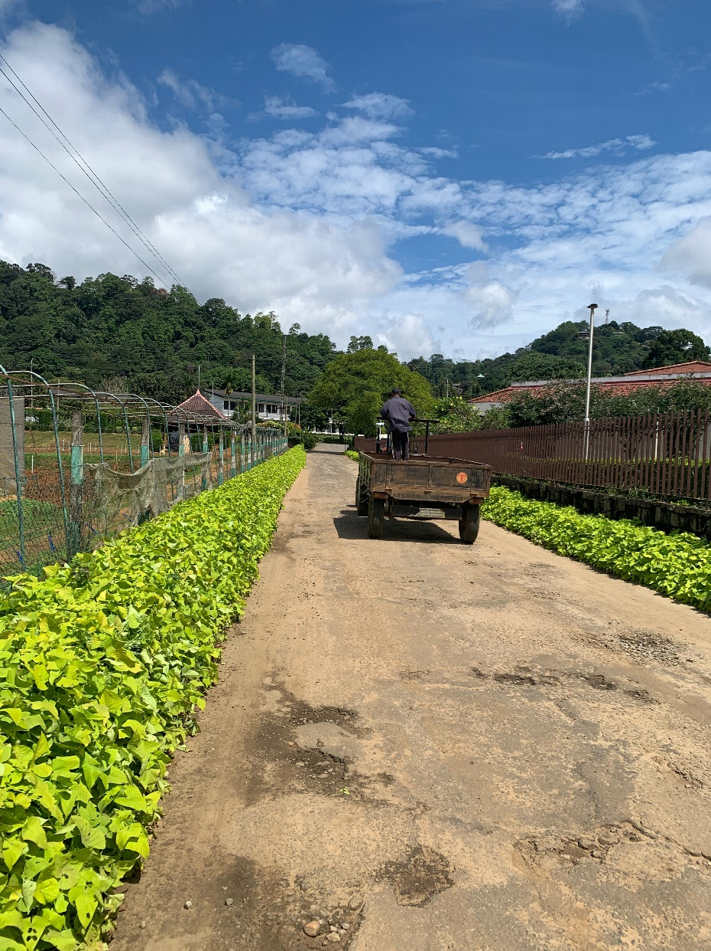
Main Objective
The objective is to develop machine learning models that predict optimal fertilizer and irrigation amounts based on plant age, NPK values, and soil moisture.
IT21277504 | Padukka P.D.M.D | 24-25J-250
Page 31

Slide 39
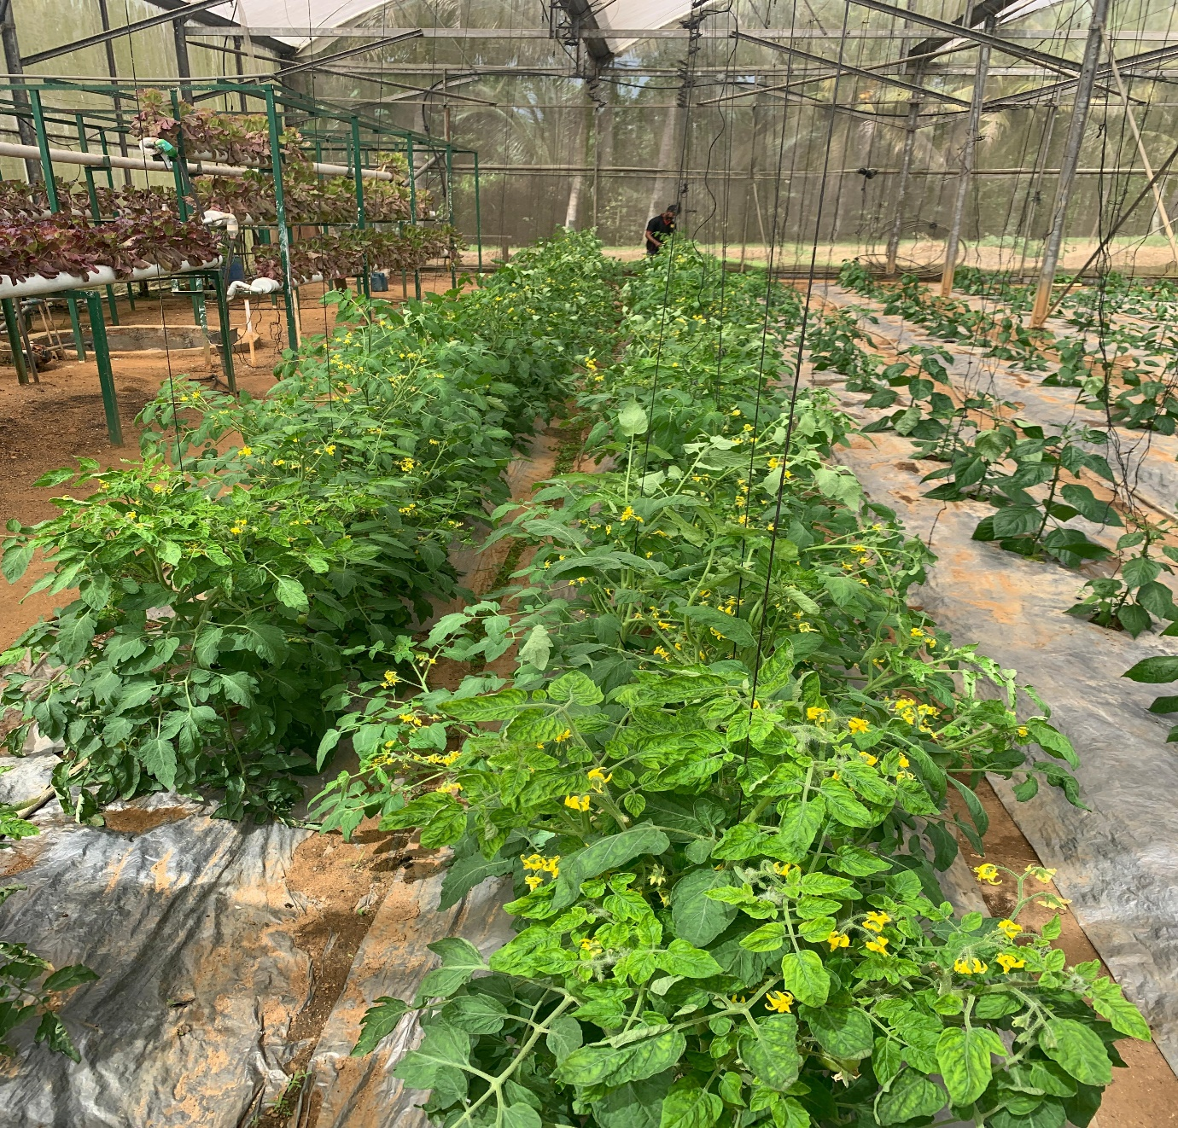
Sub Objectives
01
Resource Usage Optimization
Evaluate the effectiveness of the model in reducing fertilizer and water usage while maintaining optimal crop growth.
02
Real-time results
Use real-time soil data to adjust fertilization and irrigation rates dynamically.
03
User friendly app
Creating a user-friendly mobile app for greenhouse farmers.
04
IT21277504 | Padukka P.D.M.D | 24-25J-250
Page 32

Slide 40
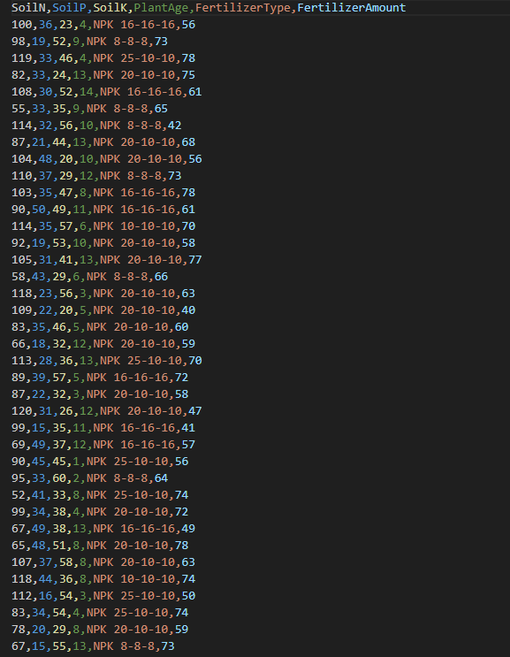
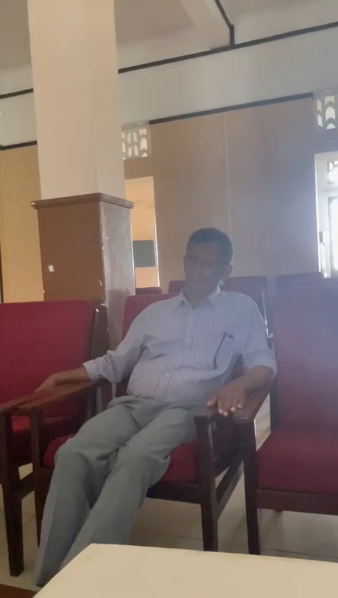
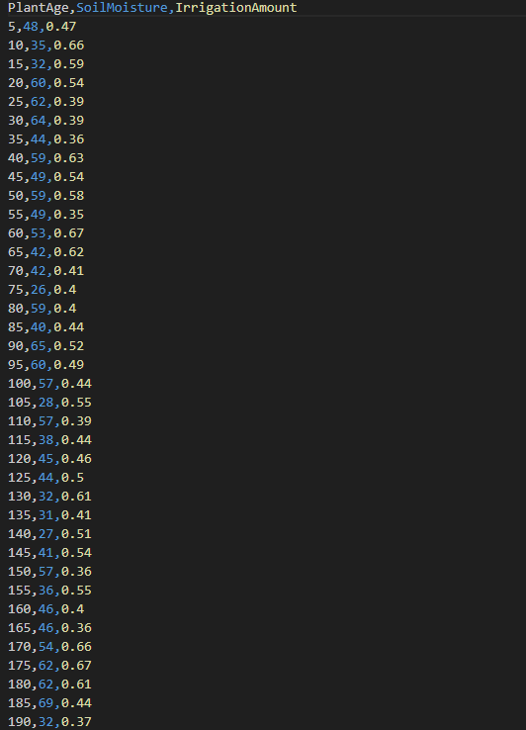
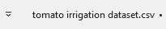
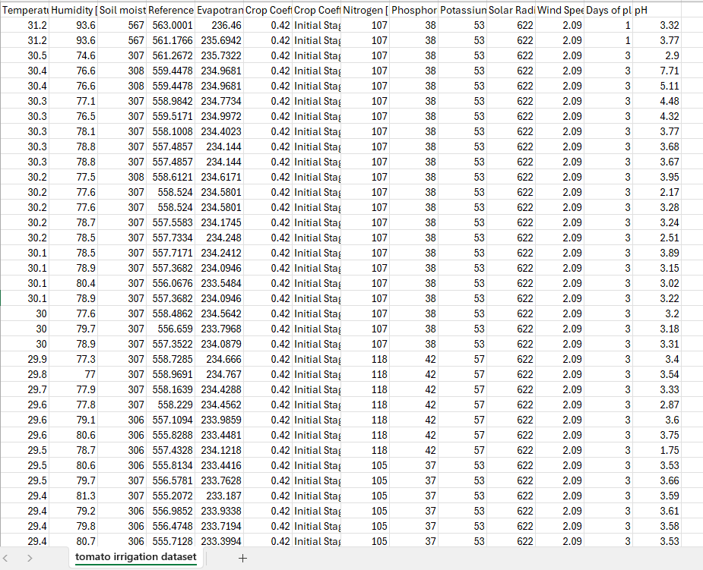
Methodology
Dataset Collection
IT21277504 | Padukka P.D.M.D | 24-25J-250
Page 34

Slide 41
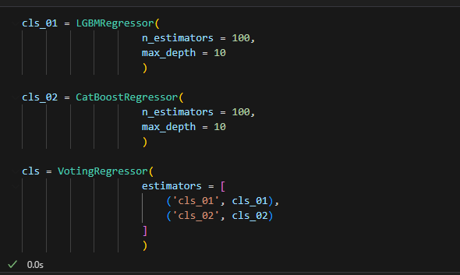
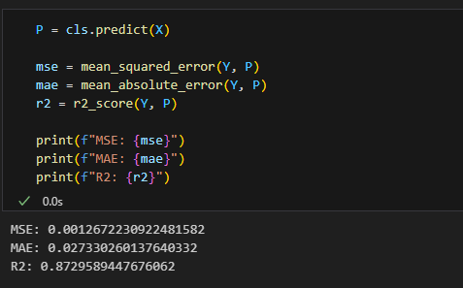


Algorithms and Accuracy
Predictive Accuracy – 0.87
Average prediction error – 0.027
Overall error – 0.0012
Predictive Accuracy – 0.89
Average prediction error - 3.17
Overall error - 14.92
IT21277504 | Padukka P.D.M.D | 24-25J-250
Page 34

Slide 42



System Diagram
Integrating Trees
IT21277504 | Padukka P.D.M.D | 24-25J-250
Page 33

Slide 43
Tools and Technologies
Technologies
Algorithms
Python
RandomForestRegressor
Flutter
XGBRegressor
Flask
VotingRegressor
Pandas
LGBMRegressor
Numpy
CatBoostRegressor
IT21277504 | Padukka P.D.M.D | 24-25J-250
Page 33

Slide 44
Completed Functions
Data Collection and Preprocessing
Model Training and Prediction
Smart Farming Techniques
Model Evaluation and Tuning
Result Generation
Mobile App Development
IT21277504 | Padukka P.D.M.D | 24-25J-250
Page 36

Slide 45

Reference
[1] D, S. (2024) Challenges of Greenhouse Labor Management and Automation, Kryzen. Available at: https://kryzen.com/challenges-of-greenhouse-labor-management-and-automation/ .
[2] Fertigation in agriculture: Benefits, methods, and applications (2023) EOS Data Analytics. Available at: https://eos.com/blog/fertigation/ .
[3] Elaydi, H.. (2017). An Automated Irrigation System for Greenhouses. American Journal of Electrical and Electronic Engineering. 5. 48-57. 10.12691/ajeee-5-2-3.
Page 38

Slide 46

Pest Identification and Management System
IT21173004 | Sandeepani A.W.S
Software Engineering
IT21173004| Sandeepani A.W.S | 24-25J-250
Page 20

Slide 47

Background
Pest management involves identifying and mitigating pests that harm crops. Advanced systems use, image processing I for pest identification and monitoring. These tools classify pests, assess infestation levels, and suggest remedies, enabling farmers to reduce crop losses, minimize pesticide use, and promote sustainable farming practices.
IT21173004| Sandeepani A.W.S | 24-25J-250
Page 21

Slide 48

Research Question?
Determine the most effective machine learning techniques for identifying and classifying pests from images
01
The effectiveness of the user interface in delivering actionable pest control recommendations
02
IT21173004| Sandeepani A.W.S | 24-25J-250
Page 22

Slide 49

Objectives
The main objective is to develop an advanced pest identification and management system, control using organic pesticides, decision support, and image processing to enhance pest control efficiency, reduce pesticide usage, and promote sustainable agriculture.
IT21173004| Sandeepani A.W.S | 24-25J-250
Page 23

Slide 50
Sub Objectives
01
The system identifies and classifies pests affecting crops by analyzing images, enabling precise identification of harmful species.
02
Use images and machine learning for accurate pest identification
03
Based on pest type and potential harm, the system provides tailored remedies, including biological controls, cultural practices, and eco –friendly pesticides, to help farmers mitigate damage effectively
04
IT21173004| Sandeepani A.W.S | 24-25J-250
Page 24

Slide 51

System Diagram
Integrating Trees
IT21173004| Sandeepani A.W.S | 24-25J-250
Page 25

Slide 52



Methodology – Evidence of Completion
Data Collection
1.Images of pests (Whiteflies) collected on-site from greenhouse
IT21173004| Sandeepani A.W.S | 24-25J-250
Page 21

Slide 53


Methodology – Evidence of Completion
Data Classifying and Resizing
Using python libraries classified and resized all the collected image data
IT21173004| Sandeepani A.W.S | 24-25J-250
Page 21

Slide 54

Methodology – Evidence of Completion
Model Architecture
Xception used for image classification :
Dense layer : These fully connected layers help the model to learn complex features.
BatchNormalization Layer : Normalizes the output of the previous layer, which helps in stabilizing training.
Dropout Layer : Helps prevent overfitting
IT21173004| Sandeepani A.W.S | 24-25J-250
Page 21

Slide 55

Methodology – Evidence of Completion
Training
Optimizer: Adam optimizer for efficient gradient decent
Loss Function: categorical_crossentropy for a multi-class classification problem (pest detection)
IT21173004| Sandeepani A.W.S | 24-25J-250
Page 21

Slide 56
Completion and Future Works
Completed Components(PP1)
Completed Components(PP2)
01
Model has successfully trained to identified the pest from an image, It outputs the identified pest name
Remedies recommendation system
Harms suggestion system
After Identifying the pest It suggest the harms that can happen to the plant
And it suggests the remedies for the relevant identified pest
Mobile Application Implementation
02
Backend implementation for firebase
Integrate backend with mobile application
IT21173004| Sandeepani A.W.S | 24-25J-250
Page 21

Slide 57
Tools and Technologies
Technologies
Programming Language
Python
Flutter
Libraries & Frameworks
Pandas
OpenCV
NumPy
TensorFlow/Keras
IT21173004| Sandeepani A.W.S | 24-25J-250
Page 21

Slide 58





Site visits
Gannoruwa Agricultural Complex
Page 58

Slide 59





Gannoruwa Horticultural Crop Research and Development Institute
&
Gamiya Green House, Galagedra

Slide 60

Thank You

